Slide 1
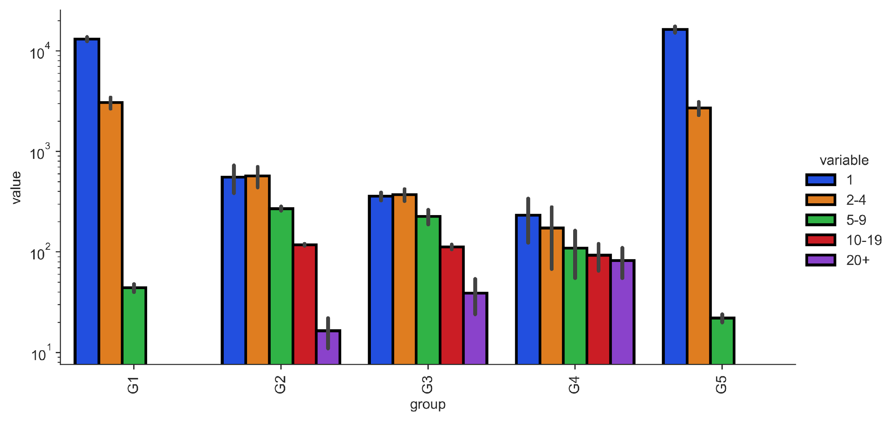
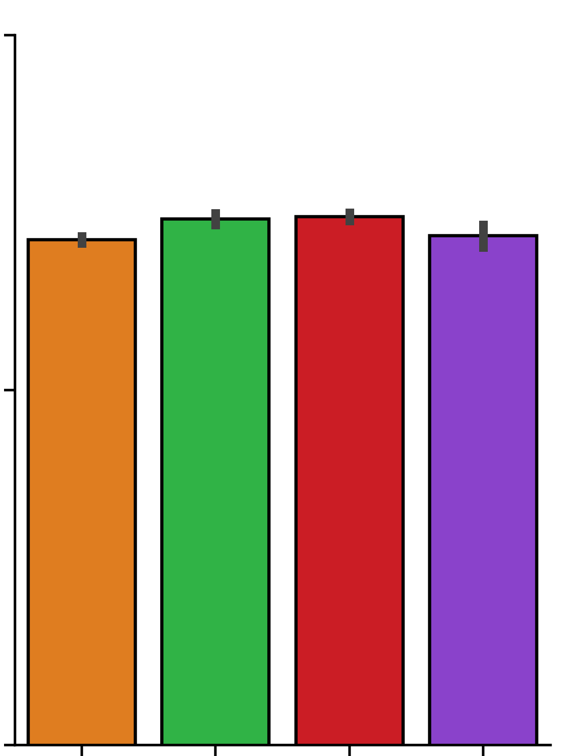
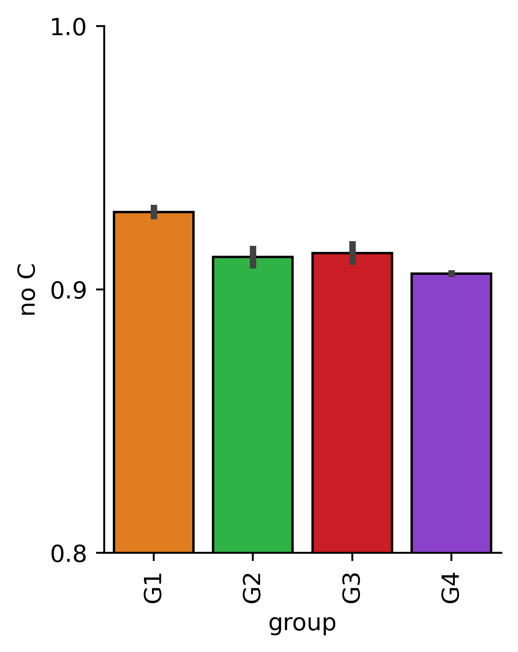
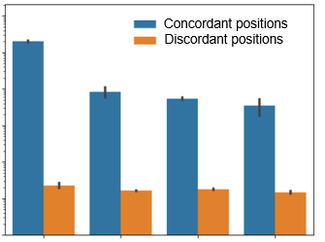
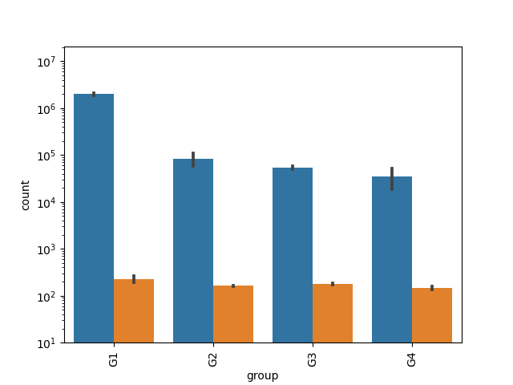
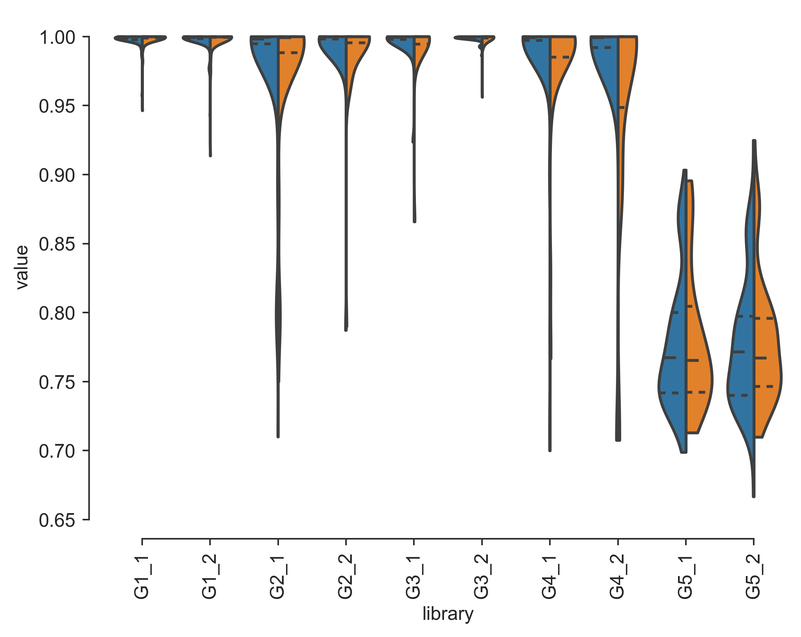
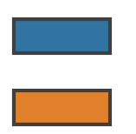
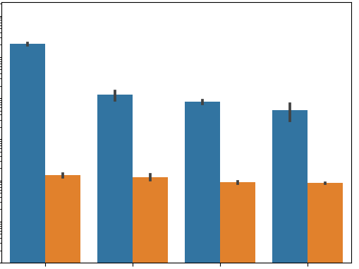
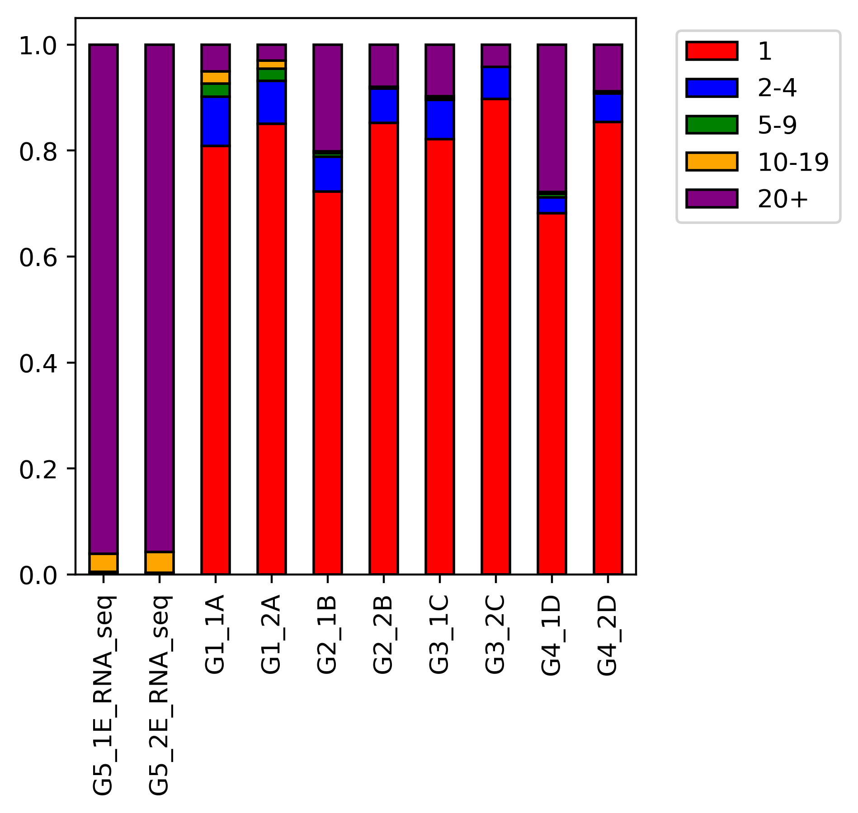
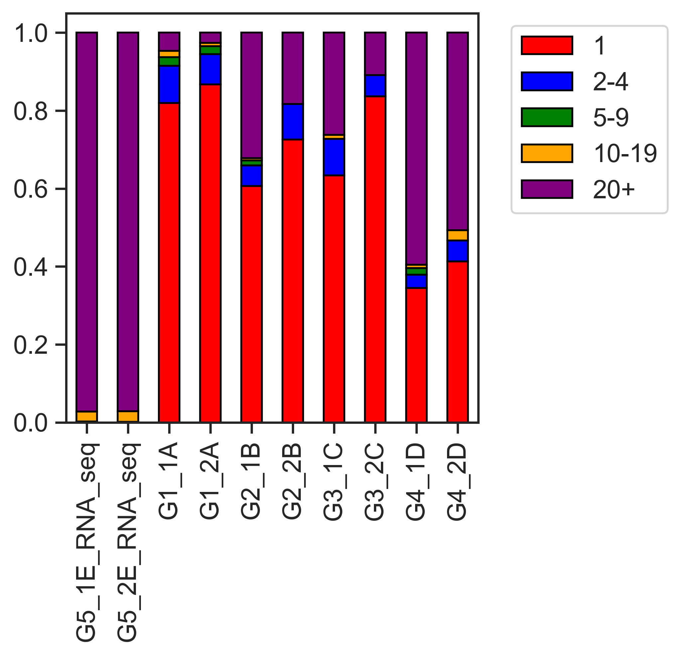
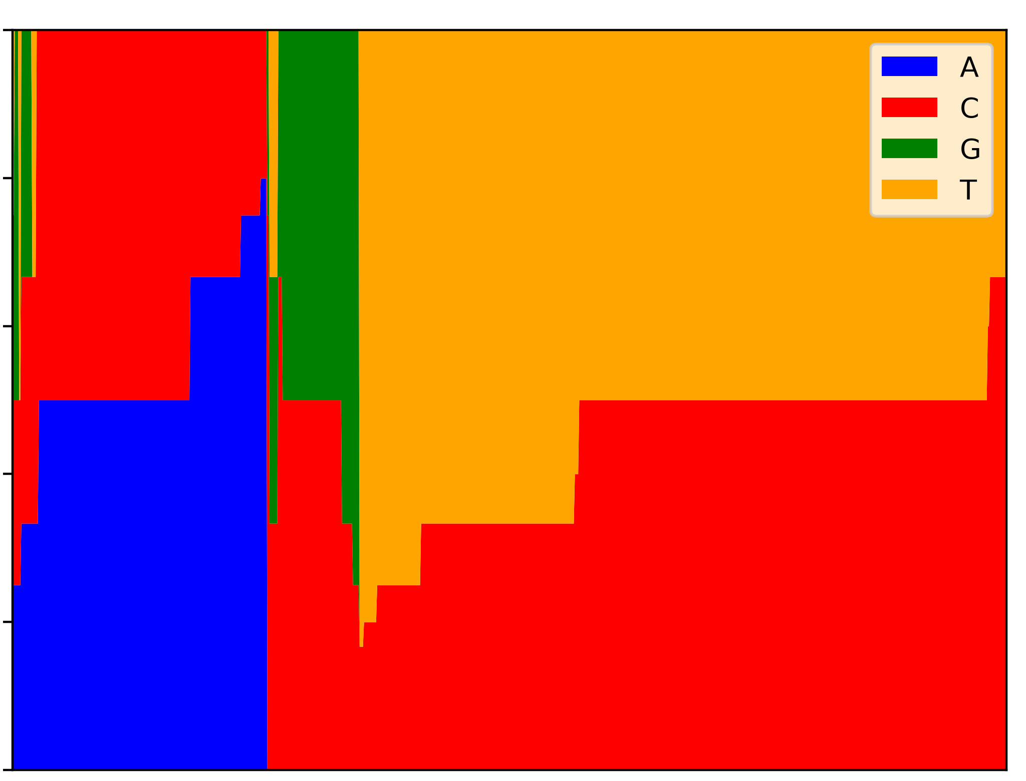
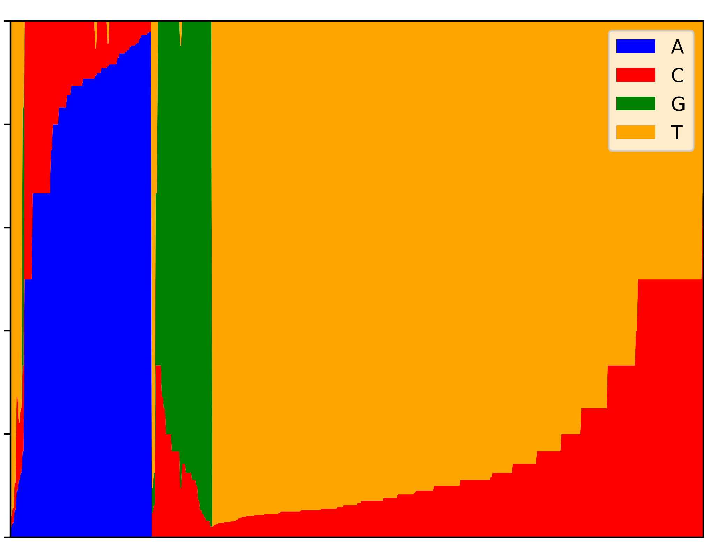

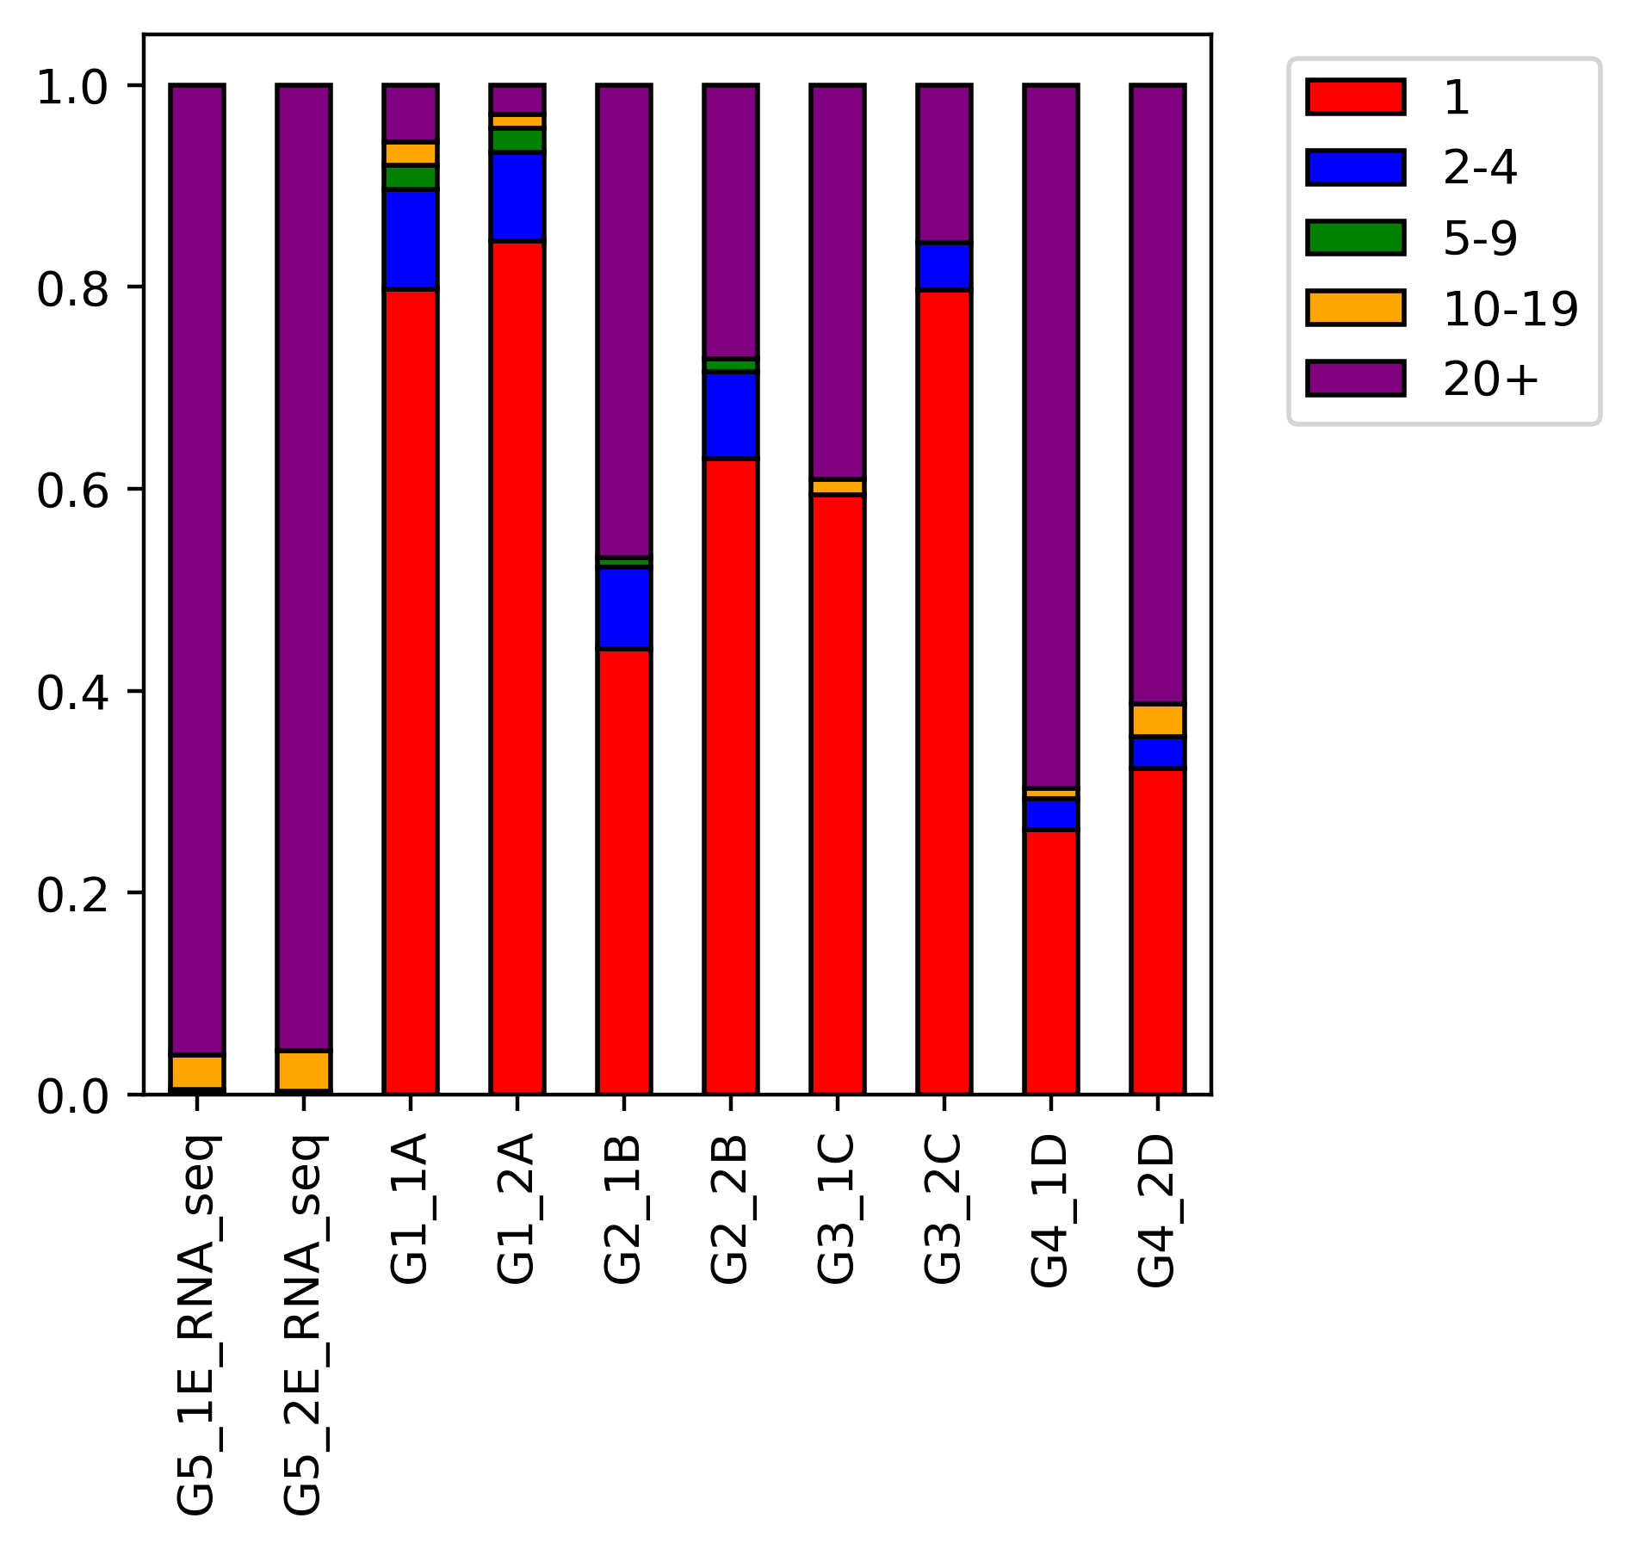
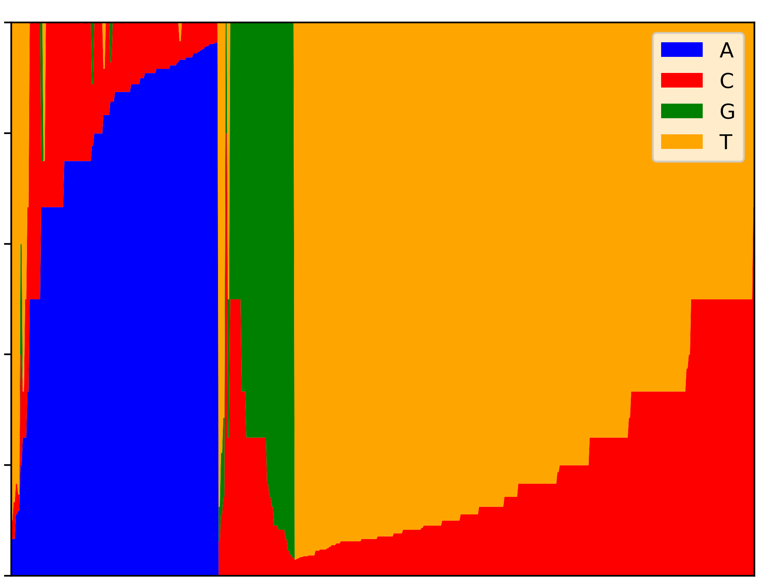
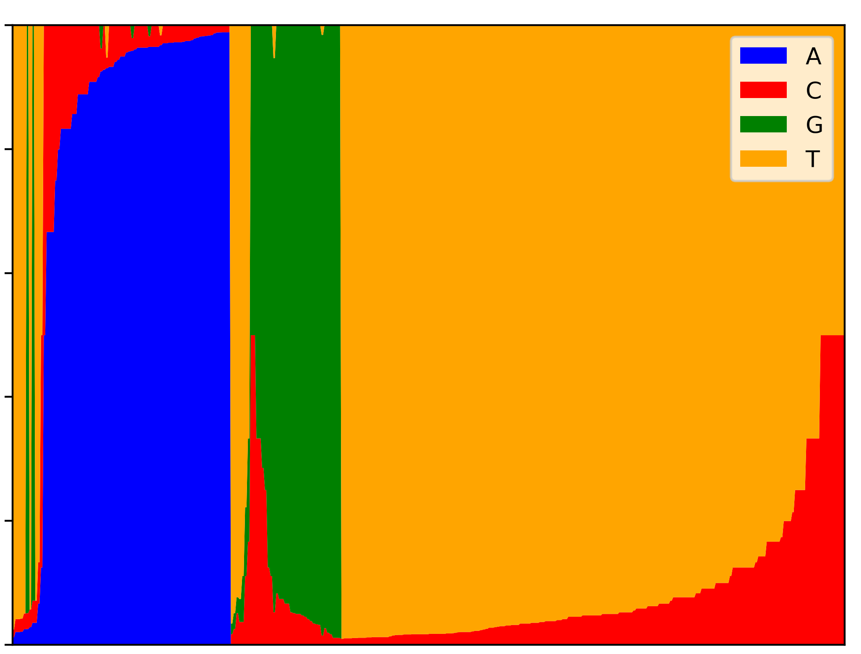
A
D
100
90
80
10⁴
10³
10²
10¹
Read depth
No deduplication
After deduplication
UMI groups with p-m⁵C
Reads without p-m⁵C (%)
MT-A
MT-B
MT-C
MT-D
MT
RNAseq
MT-A
MT-B
MT-D
MT-C
MT-B
MT-D
B
UMI groups with p-m⁵C
UMI groups with “T”
MT-A
MT-C
0.0001 | 0.003 | 0.004 | 0.007
0.0001 | 0.003 | 0.004 | 0.007
E
Mean conversion rates:
10⁷
10⁵
10³
10¹
Non-dedup |  | 0.998 | 0.997 | 0.991 | 0.991 | 0.993 | 0.997 | 0.995 | 0.979
Dedup |  | 0.998 | 0.997 | 0.976 | 0.989 | 0.992 | 0.998 | 0.983 | 0.958
1.0
0.9
0.8
0.7
Conversion rate of ERCCs
Number of Occurances
UMI groups with “G”
UMI groups with “A”
Non-dedup
Dedup
10⁷
10⁵
10³
10¹
0.0001 | 0.003 | 0.004 | 0.008
0.0006 | 0.010 | 0.011 | 0.016
F
MT-A
MT-B
MT-C
MT-D
1.0
0.8
0.6
0.4
0.2
0.0
No deduplication
p-m⁵Cs per read
MT-A
MT-B
MT-C
MT-D
MT-A
MT-B
MT-C
MT-D
C
1.0
0.8
0.6
0.4
0.2
0.0
MT-A
MT-B
A
T
G
C
Proportion of reads
After deduplication
1.0
0.8
0.6
0.4
0.2
0.0
Nucleotide proportion
MT-C
MT-D
1.0
0.8
0.6
0.4
0.2
0.0
MT RNAseq
MT-A
MT-B
MT-C
MT-D
Figure 3. PCR deduplication and bisulfite conversion of ERCC spike-in transcripts. (A) UMI-duplicate coverage of ERCC transcripts containing p-m⁵C artifacts. UMI-duplicates are defined as reads containing identical UMI barcodes and mapping coordinates. (B) Discordance ratio of each nucleotide (p-m⁵C, T, G, A) among duplicated ERCC-mapped reads as defined above. Discordance rates were measured as the proportion of UMI-groups containing discordant positions over total UMI-groups. Read-positions with the same UMI barcode were considered concordant if the read-position shared complete similarity with all other read-positions in its group. The number of discordant reads for each nucleotide (A, T, C, and G) were calculated if any dissimilarity at a position was observed. The concordance-discordance ratio is displayed above the chart. (C) Nucleotide frequencies of discordant positions containing p-m⁵C bases within ERCC-mapped reads. (D) Percent of reads without any p-m⁵C sites in ERCC reads before and after UMI-deduplication. (E) p-m⁵C content of ERCC-mapped reads before and after UMI-deduplication. RNA-seq and RNA BS-seq libraries are shown. p-m⁵C content was quantified and binned accordingly. (F) Conversion rates of individual ERCC IDs before and after UMI-deduplication. Dashed lines represent the mean conversion rate of the library. Mean conversion rates are displayed above each violin plot.

